Slide 1
Safety First,
Safety Always
Essex Partnership University NHS Foundation Trust
Year 3 report

Slide 2

Foreword from our Chief Executive
We launched our patient safety strategy, Safety First, Safety Always, in 2021 with an ambition to provide the safest possible care for our patients. This commitment applies in all our services, however and wherever people receive our care. The year 1 and year 2 reports consolidated this ambition – you can read them on our website, along with the full strategy.
Our first and most vital priority was to set out and deliver improvements in inpatient care so that patients and their families can feel assured that they will be well looked after and kept safe, whenever they are in our care. Our Executive Team and local leadership teams remain wholly committed to delivering a vision of making Essex Partnership University NHS Foundation Trust (EPUT) the safest possible organisation. This is the agenda that drives everything we do and the evidence shows that it is having a real, visible and measurable effect in the organisation.
At the end of the third and final year of the Strategy we must recognise that, while there has been significant progress, we still have more to do to build and maintain the confidence of our patients, their families and carers and our partners. Although feedback from our patients, their families and carers tells us that many people get excellent care and support from EPUT, there are still too many instances where this is not the case and where people feel we have failed them or have not treated them with the kindness and understanding they should expect. I am very clear that one person who has a bad experience in our care is one person too many, and I am determined that we will continue to improve. It must be our number one priority to provide the safest and best possible care for everyone who needs our services - and at the same time give them confidence in our services, without concern for their safety or the standards of their care.
Paul Scott
Chief Executive
Essex Partnership University NHS Foundation Trust

Slide 3

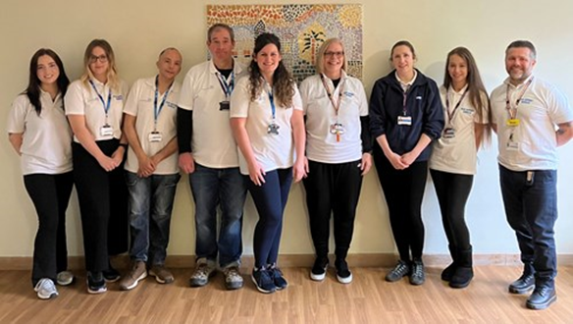
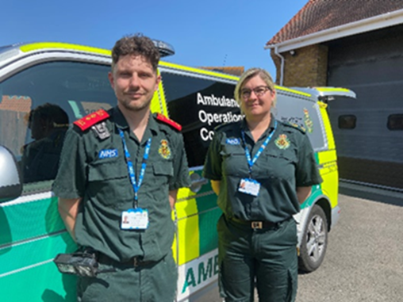
As we continue to improve our services and evaluate that improvement, we do so in the context of the Lampard Inquiry into deaths in Essex mental health services across an almost 24-year period, which will bring additional intense scrutiny and will revisit incidents and learnings that have already taken place. We are completely committed to supporting the Inquiry to deliver on the scope and terms of reference that are now established - it is vital that patients, families and carers get the answers they deserve and that we act decisively on the Inquiry’s recommendations.
It is also important that we reflect on the successes we have achieved with our staff, patients, communities and partners in the last three years. Staff across the Trust have shown extraordinary commitment. Against a backdrop of both unprecedented demand and workforce challenges, our people have truly embraced the Safety First, Safety Always message.
Our work has gained national recognition in key areas - for example, our national award-winning apprenticeship in Clinical Psychology (which is helping to address the workforce challenges of the present and future) and our Mental Health Urgent Care Department have both been recognised as examples of best practice by NHS England.
As the Safety First Safety Always Strategy comes to an end, our new Quality of Care Strategy takes forward a significant legacy of improvements and gives us an incredibly strong foundation on which to continue building. We look forward to doing this in collaboration with patients, carers, families and partners to make EPUT the safest possible organisation for delivering patient care.

Slide 4
Executive summary
The strategy’s key ambitions

Slide 5
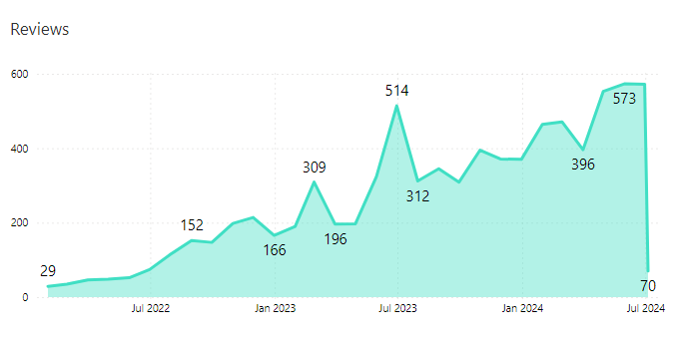
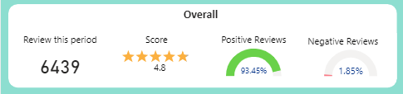
Summary of the strategy's impact
Safety First, Safety Always laid out five key ambitions and outcomes for delivery over three years. The combination of actions we have taken to improve safety of care at EPUT in the last three years has driven demonstrable improvements against each of these.
Patients and families feel safe in EPUT’s care
Since its implementation in October 2022, patients have shared their experience of EPUT’s care via I Want Great Care (iWGC)
Through five consecutive quarters, EPUT has seen a rising trend, with 98.2% of patients and families stating they feel safe in our care in December 2023 - a 6.3% increase from December 2021
This is in the context of a rising trend in overall numbers of patients using iWGC to feed back to us. We received 82% more feedback in December 2023 than in October 2022
Reviews over time

Slide 6




Summary of the strategy's impact
Stakeholders have confidence that EPUT is a safe organisation
Feedback from stakeholders and partners indicates that other organisations are starting to see EPUT as a more transparent and open system partner
Closer working relationships developed with MPs and local council scrutiny committees
Whilst MPs and scrutiny committees report fewer complaints, we continue to work with them to address concerns and share our challenges
EPUT services have been shortlisted in several national award schemes
Our education centre at the St Aubyn inpatient unit was rated Outstanding by Ofsted in 2024

Slide 7
Summary of the strategy's impact
No preventable inpatient acute adult deaths attributable to self-harm
Since September 2022, there have been no deaths associated with incidents of self-harm in acute adult mental health inpatient services
Notes:
Talk to Didier to agree

Slide 8
Summary of the strategy's impact
A reduction in Patient Safety Incidents for Investigation (PSII)
We were an early adopter of the NHS’s Patient Safety Incident Response Framework (PSIRF), introducing it in May 2021 – this replaced the previous serious incident framework (SIF)
PSIRF investigates incidents thematically rather than in isolation, providing a clearer picture of the underlying issues affecting safety and effectiveness of care
We have seen a reduction in the number of incidents requiring investigation (PSII)
Analysing PSIRF data over the last three years shows improvements in key areas of patient safety, including:
  Inpatient deaths from self-harm – see slide 7
  Self-harm by fixed ligature
  Restraints – including use of prone restraint
  Grade 3 and 4 pressure ulcers - those causing the most harm
  Patient falls
We are still on an improvement trajectory, including addressing those areas where we still need to improve

Slide 9
Summary of the strategy's impact
A reduction in self-harm
Reported self harm incidents show a rising trend over the three years of the strategy
Over the same three year period, EPUT has been building a culture of increased incident reporting as an enabler of learning and continuous improvement, so the increase in self harm reports is expected
The proportion of reported self harm incidents resulting in moderate or above harm has been maintained at or below 2.7% since November 2022
Our new Quality of Care strategy takes these improvements forward as we work towards our ambition to eradicate avoidable harm

Slide 10
Establishing the context
Background to the Strategy and what we set out to achieve

Slide 11
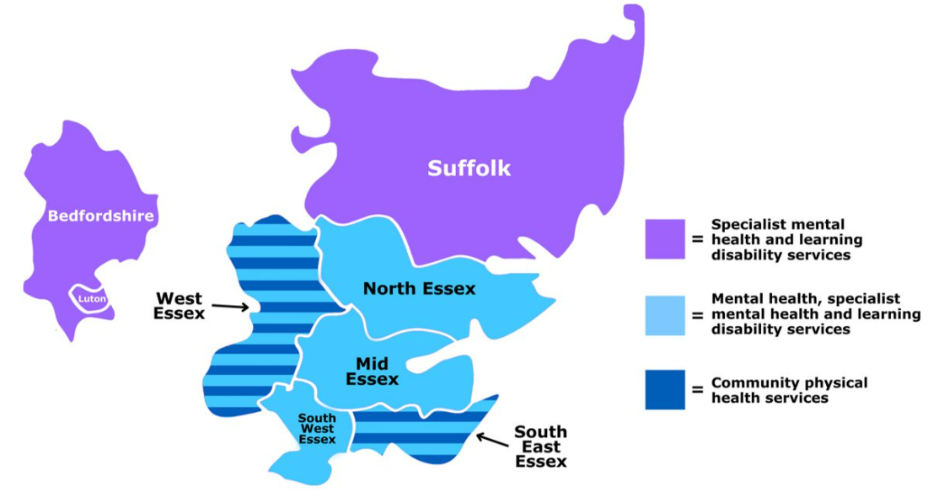
Who are we?
We provide community physical and mental health services to over 3.2million people living across Essex, Thurrock and Southend as well as in Luton, Bedfordshire and Suffolk
EPUT was formed in 2017 after the merger of the former South Essex Partnership and North Essex Partnership trusts
EPUT operates across four Integrated Care Systems: Bedfordshire, Luton & Milton Keynes; Hertfordshire & West Essex; Mid & South Essex and Suffolk & North East Essex
We are a large employer, with around 7,500 staff working across over 200 sites
We also provide services in people’s homes and in community settings, including schools, GP practices and health clinics
Around 100,000 people are in our care at any one time

Slide 12
The wider picture
Mental health services in context
Demand for mental health services is increasing, whilst the population of the county of Essex is growing at one of the fastest rates in England – predicted to increase by 2.9% between 2022 and 2027
The population is also ageing, with increasingly complex health and social care needs
People who need our help are increasingly more unwell, with more complex needs
All health and care organisations face additional pressures to recruit and retain staff and to meet demand within stricter budgetary requirements
Working together to care for people when they need us most
We work closely with local system partners to help people get the care they need more quickly when they are experiencing a mental health crisis
Introducing innovative new services such as our mental health urgent care department in Basildon helps free up capacity in the wider emergency care system, helping many other people get the care they need

Slide 13

Our strategy for ensuring patient safety
The Safety First, Safety Always strategy was agreed by the Trust Board in February 2021, following widespread engagement with Trust staff, Non-Executive Directors, Governors and partners. It set out our ambition to be an organisation that consistently places patients’ and families’ safety at the heart of everything it does.
The strategy recognised the need for a change in culture and an organisation-wide mindset of Safety First, Safety Always. It reflected learnings from the past and themes from incidents over the preceding 20+ years.
We set out five key ambitions and outcomes:
Patients and families feel safe in EPUT’s care
Stakeholders have confidence that EPUT is a safe organisation
No preventable deaths
A reduction in Patient Safety Incidents for Investigation (PSII)
A reduction in self-harm
This report highlights the progress we have made against the priorities within this three year strategy and against the four priority areas for quality improvement in NHS England’s Mental Health Safety Improvement Programme, now incorporated into NHS England’s Culture of Care Standards for Mental Health Inpatient Services.
It also sets out the context for our Quality of Care Strategy which launched at the end of April 2024 and builds on the work of the safety strategy to ensure that EPUT is a leader in providing outstanding patient safety and care.

Slide 14
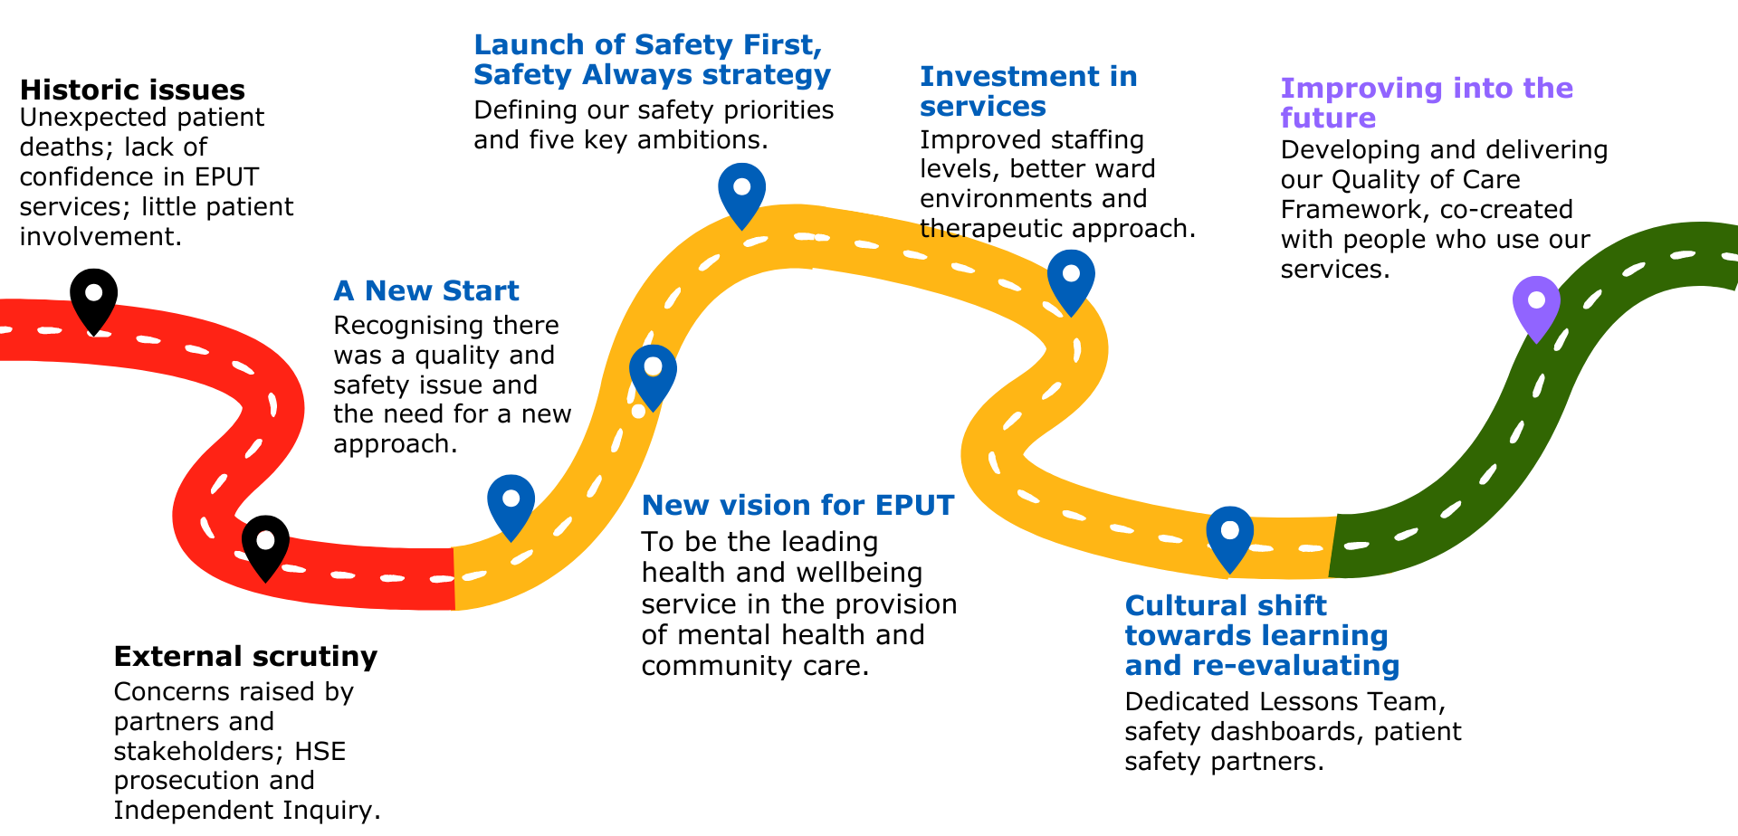
Programme roadmap

Slide 15
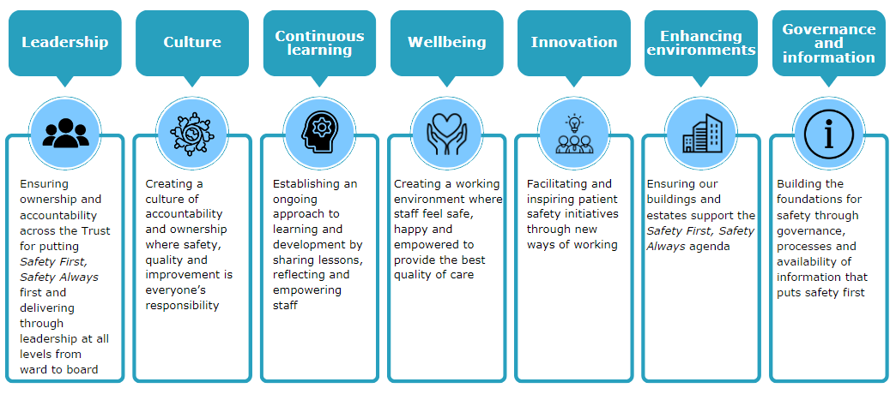
Seven improvement themes

Slide 16
Reviewing our progress
What we’ve delivered for our patients and communities

Slide 17

PATIENT VOICE IN SAFETY
Priority initiatives
Further development of I Want Great Care to enhance the quality, quantity and application of patient feedback to care practices
Instil a culture of systematically capturing and embedding patient feedback in everything we do
Further increasing the number of people with lived experience engaged in our improvement work
Increasing the number of our Patient Safety Partners, strengthening their voice and enhancing their role in safety and quality improvement
Highlights
22% year on year increase in I Want Great Care responses, with a consistent trend of improvement since launch
Changes to practice are slowly driving an improving trend in the proportion of patients and families who say they feel safe in EPUT’s care
Patient experience dashboard created for each Care Unit, supported by data insight to drive quality improvement; oversight via Care Unit quality and safety meetings and Accountability Framework meetings for executive assurance
Doubling of Lived Experience Ambassador team to 250 - ambassadors have been integral to the creation of the Quality of Care Framework
Doubling of Patient Safety Partners to 11, focusing on establishing the Safewards programme and safety walkabout visits
Ensuring the patient voice is listened to, understood and acted on is key to embedding safe, good quality care throughout the organisation in all our care settings

Slide 18
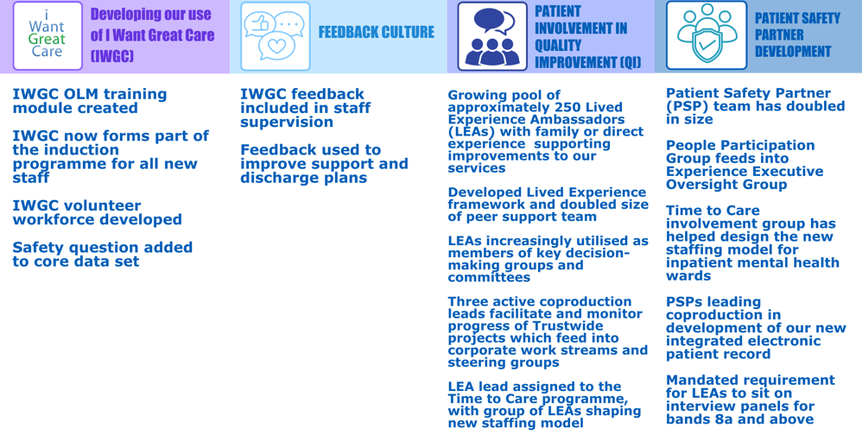
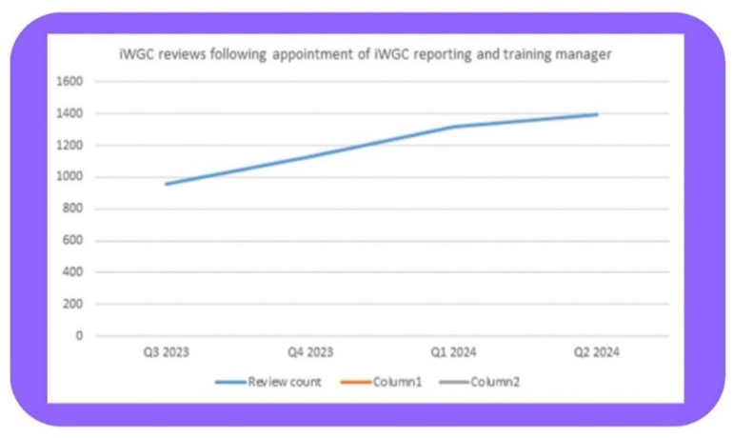
Patient voice in safety - highlights

Slide 19

CULTURE OF SAFETY
Priority initiatives
Creation and embedding of the Trust’s People Charter
Continuing to foster a culture of reporting and speaking up
Instilling a sense of empowered leadership throughout the wards
Identify any learning or recommendations emerging from the Lampard Inquiry
Rolling out Quality Together to ensure a shared culture of accountability, working with system partners and patients
Truly embedding our process and practice improvements at ward level and throughout every care setting
Enhancing the outcomes of our work using Quality Improvement methodologies
Highlights
Scoped development of People Charter to be taken forward as part of our new People & Education strategy
Created just, learning and caring culture principles
Continued to develop Freedom to Speak Up processes and encourage colleagues to raise issues
Committed to supporting and learning from the Lampard Inquiry as it progresses
Held seven Quality Together meetings with Integrated Care Boards and NHS England, focusing on safety deep dives and related actions
Utilising a “single front door” approach for all quality improvement work, developing knowledge and skills to improve standards of care delivery
Embedding the highest professional standards to become a Patient First organisation

Slide 20



Culture of Safety
Continuing to foster a culture of reporting and speaking up | Instilling a sense of empowered leadership throughout the wards | Rolling out Quality Together to ensure a shared culture of accountability, working with system partners and patients | Utilising a “single front door” approach for all quality improvement work, to improve standards of care delivery
254 Freedom to Speak Up (FTSU) contacts received Adopted national FTSU principles to align with Trust values: Speak Up – We Care Listen Up – We Learn Follow Up – We Empower Over 400 Trust managers attended one of 11 manager listening events Information from staff around sexual safety has led to: Review of Trust policies and procedures Creation of a 24/7 dedicated sexual safety line | Coproduced Ward Manager Development Programme has five modules: Foundations/learning from lived experience Being great leaders Workforce development Professional practice and leadership enabling skills High performing teams 31 ward managers have completed the competency-based programme to date Introduced new site manager roles on two sites to provide 24/7 senior oversight for inpatient wards | Seven Quality Together meetings held with system partners which discussed ‘deep dives’ undertaken on: Workforce Mixed sex wards Sleeping on duty Patient racism towards staff Successful roll-out of the Safewards initiative Health checks for people with severe mental illness Coroners’ Prevention of Future Deaths reports Pharmacy workforce Safeguarding Workforce quality impact Out of area placements ADHD Services Early Intervention Psychosis service | Quality Improvement (QI) methodology has utilised the ‘Single Front Door' route to capture all improvement work. A QI programme has been designed to develop the knowledge and skills needed to improve and sustain standards of care This work will continue through the Quality of Care Strategy

Slide 21
Culture of Safety
Established new structures that support a culture of reporting and speaking up, part of improvements made to meet our objective to embed the highest professional standards to become a Patient First organisation.
Increase in numbers of staff speaking up via the FTSU process. Further work ongoing to create a timely, supportive, responsive environment by demonstrating our ability to ‘listen up’ and to ‘follow up’.
Created a bespoke Ward Manager Development programme with support from our lived experience ambassadors, senior nursing and quality leaders. All ward managers were offered a place on the programme over the past year. Feedback has been positive and led to new quality improvement projects being established by participants.
Established the Quality Together forum with the ethos of partnership across our systems to achieve quality assurance in collaboration with partners. Areas of focus are now informing continuous improvement programmes in 2024/25.

Slide 22

DATA-INFORMED STRATEGY
Priority initiatives
Review our Business Intelligence capability and develop a new future-state model
Continue to develop the data that is collected and turn our data into insight to improve the quality of prioritisation and decision making
Embedding use of Safety Dashboard data from ward to board, ensuring robust communication with and understanding of staff across the organisation
Development of ward-level quality assurance framework that provides oversight and evidence on safety of care
Highlights
Agreed the Trust’s data strategy with a five-year plan to level up data intelligence capability, quality and maturity via a Microsoft Cloud data platform
Developed a target operating model for business intelligence and data analytics, laying the foundation for using data to drive quality and capability
Developed a new data quality assurance framework to improve data quality and availability to inform clinical and corporate services
Launched a managers’ insight dashboard to inform delivery of safe care and quality improvement
Put in place new quality assurance framework to support the Quality of Care framework
Continued roll out and increased utilisation of patient safety dashboard
Making the best use of data to inform decision making, oversight and continuous improvement

Slide 23
Data-informed strategy - highlights
Review our Business Intelligence capability and develop a new future-state model
Board approved data strategy setting out vision of EPUT as a data insight driven organisation with a 5 year plan to level up data intelligence capability, quality and maturity
New Microsoft Cloud hosted data platform as single source of truth for data intelligence, leading to automation of self-serve, data driven decision making
Significantly progressed new target operating model for business intelligence and analytics to modernise data analytics to drive efficiencies and new capabilities
New data quality assurance framework based on best practice from national guidance to support improved data quality and availability
Continued development of Microsoft Power BI
Continue to develop the data that is collected and turn our data into insight to improve the quality of prioritisation and decision making
Launched monthly integrated performance report on Power BI with safety KPIs part of the Quality domain. Trends reviewed monthly through care unit governance, Accountability Framework and Executive and Board Quality Governance structures
Developed safety dashboard and managers’ insight reports
Working on triangulation of different sources of safety data to ensure monthly scrutiny of trends, learning and oversight of actions to embed this in maturing Quality Governance structures
In the second half of 2023, we saw a positive increase in reported incidents (64 in July to 71 in December) which we see as more valuable opportunities to analyse what happened and improve ways of working to avoid reoccurrence
Embedding use of Safety Dashboard data from ward to board, ensuring robust communication with and understanding of staff across the organisation
Over the past year, we have witnessed a significant surge in the utilisation of the Patient Safety Dashboard. The number of users has grown from 77 to 220, reflecting increasing value and demand for the tool.
To further enhance the dashboard’s utility, we have recently included the Managers’ Insights report which provide tailored insights for managers across various service areas. Additional reports added include iWantGreatCare reports
The dashboard's ability to display trends and patterns has enabled us to conduct in-depth reviews into e.g. absconscions and sleeping on duty, leading to informed recommendations for service improvements
This proactive approach allows us to address issues more effectively and supports our commitment to maintaining the highest standards of patient safety and service quality
Development of ward-level quality assurance framework that provides oversight and evidence on safety of care
Developed new Quality Assurance Framework aligned to the development of the Quality of Care strategy
Tactical development group oversaw development of quality planning priorities, review of audit tools such as Tendable and data to support controls
Developed new assurance visit methodology

Slide 24
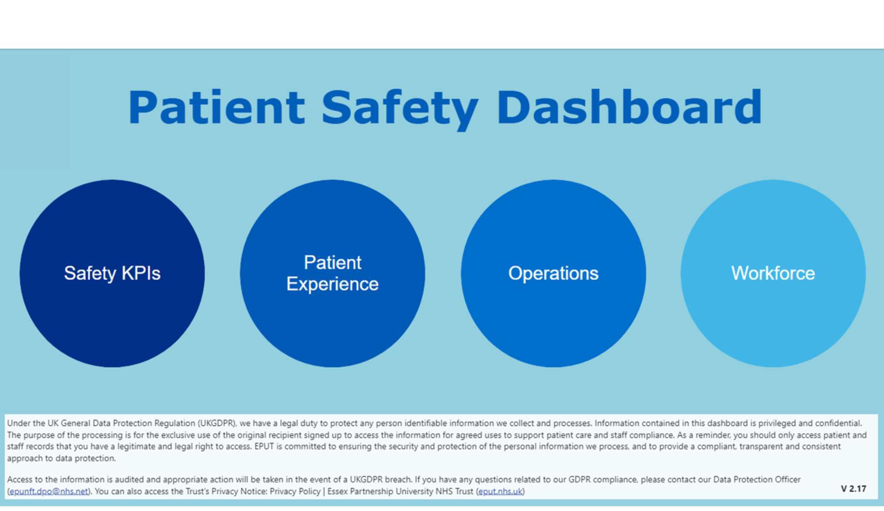
Data-informed strategy - highlights
Patient Safety Dashboard enables clinical staff to use data to make more informed decisions
Dashboard uses established software which supports intelligent use of data
Data is shown in real time and enables staff to interrogate data and identify trends at service level to inform service improvements

Slide 25

PARTNERSHIPS AND SAFETY
Priority initiatives
Build on the work of our Patient Safety Partners to co-design and co-produce services
Using Quality Together to improve collaboration with Integrated Care Boards and other system partners
Essex Police Mental Health Team
Mental Health Urgent Care Department
Deepening our partnership with primary care
Increasing the presence and visibility of Independent Mental Health Advocates
Highlights
Patient Safety Partners have co-designed and co-produced new services and guidance and the Trust’s first co-production conference
Built on strong relationships with Essex Police and primary care teams to deliver holistic care for people in mental health crisis, with EPUT nominated for Essex Police’s Public and Partnership award
Opened the Mental Health Urgent Care Department at Basildon Hospital, part of a new and successful urgent care pathway to support people experiencing a mental health crisis and support the Mid and South Essex emergency and urgent care pathway. The Department was shortlisted for three national awards
Independent Mental Health Advocates are provided by independent charities and the service is promoted to inpatients
Building system partnerships and working ever more closely with colleagues to provide the safest possible care.

Slide 26
Partnerships and safety - highlights
Building on the work of our Patient Safety Partners (PSPs) to co-design and co-produce services
Patient Safety Partner members co-designed and co-produced key service priorities, including:
Time to Care programme
Staff buddy scheme
Mental Health Urgent Care Department
Updated guidance for therapeutic engagement and supportive observations
Adult Eating Disorders service users’ network
Inaugural Co-Production Conference to showcase the valuable contribution made to services by people with lived experience
Development of Quality of Care Strategy
Development of bespoke EPUT patient safety partner handbook, including guidelines and regulations, PSP rights and responsibilities and PSP code of practice
Working with the Essex Police Mental Health Team
Continued to build on strong relationship with Essex Police to ensure collective response puts a person in crisis at the heart of all decisions through ongoing development of the Essex Crisis Care Concordat
Focus on ensuring a smooth transition to the nationally approved Right Care Right Person model
Memoranda of Understanding developed specifying agreed outcome measures
Essex Police take part in twice daily sit rep calls to ensure smooth and proactive care of patients held on a section 136 requiring transfer to a health based place of safety – reducing handover times as a result
Trust nominated by Essex Police for its Public and Partnership award
Supporting people experiencing a mental health crisis
Developed our Mental health Urgent Care Department which has cared for over 3,400 patients since opening in March 2023
Most patients leave the Department within five hours with a care plan in place and/or a plan for admission to an inpatient ward
Far fewer are admitted to an inpatient facility as a result
Seamless transition to mental health crisis and liaison teams; close links to housing and social care
Helping to resolve issues which can lead to repeat A&E attendance
Supports entire Mid and South Essex system by improving flow within the urgent care pathway, reducing ambulance handover times and helping reduce mental health A&E 12hour trolley wait breaches by over 90%
I Want Great Care scores show 91% of patients rated their experience of the centre as positive
Introduced joint ambulance response cars to care for people in the community
Over 2,000 people seen by the car teams, over 80% of whom could remain at home or in the community for support
Working with local authorities
Closer integration of local authority, physical and mental health services to reduce handoffs and avoid patients being dropped between services

Slide 27
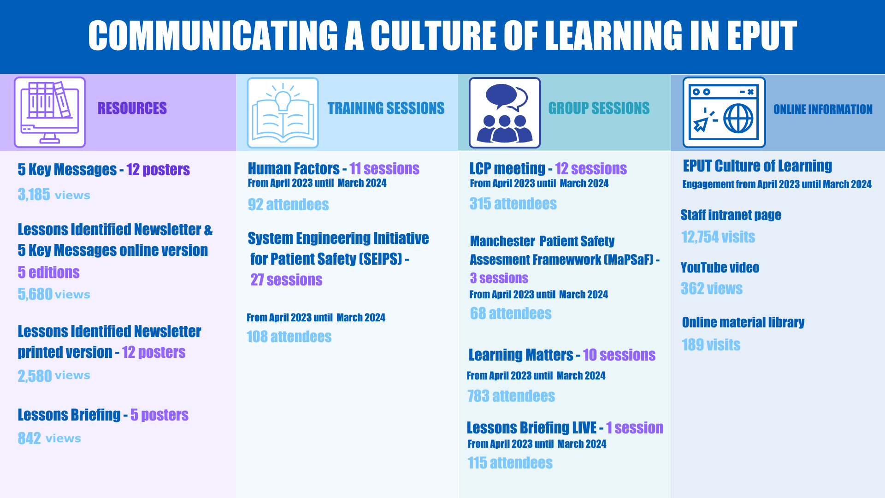
Objective
We will continue to embed what we have learned since the launch of this strategy to ensure consistent good practice across the Trust
EMBEDDING LEARNING

Slide 28
Objective
We will continue to embed our learnings since the launch of this strategy to ensure consistent good practice across our services
EMBEDDING LEARNING
Methods of cascading lessons learned
Sharing investigation reports with patients and families/carers
Two way communications
Five Key Messages – making it easier for staff to see and understand key actions to take
Lessons Identified Newsletter
Live Learning Sessions – Learning Matters
Safety Alert Learning Call (SALC)
Learning Collaborative Partnership
Feedback from our Patient Safety Partners (PSPs)
‘‘I attended my first Learning Collaborative Partnership meeting in March 2024. It was good to see a broad representation of staff working together to improve services and safety. The presentations were informative and educational. I enjoyed the presentation on the SEIPS Framework, and the importance of this to improving our incident response.”
“The work on the Newsletter and the Five Key Messages is valued across the organisation and it was great to be a part of these discussions. Good to hear the Trust is making ongoing efforts to improve communication with patients and family members. I'm looking forward to attending future meetings and sharing knowledge from my PSP role.’’

Slide 29
Looking to the future
Embedding learnings and taking continuing improvement forward with our patients, families, carers, staff and partners

Slide 30
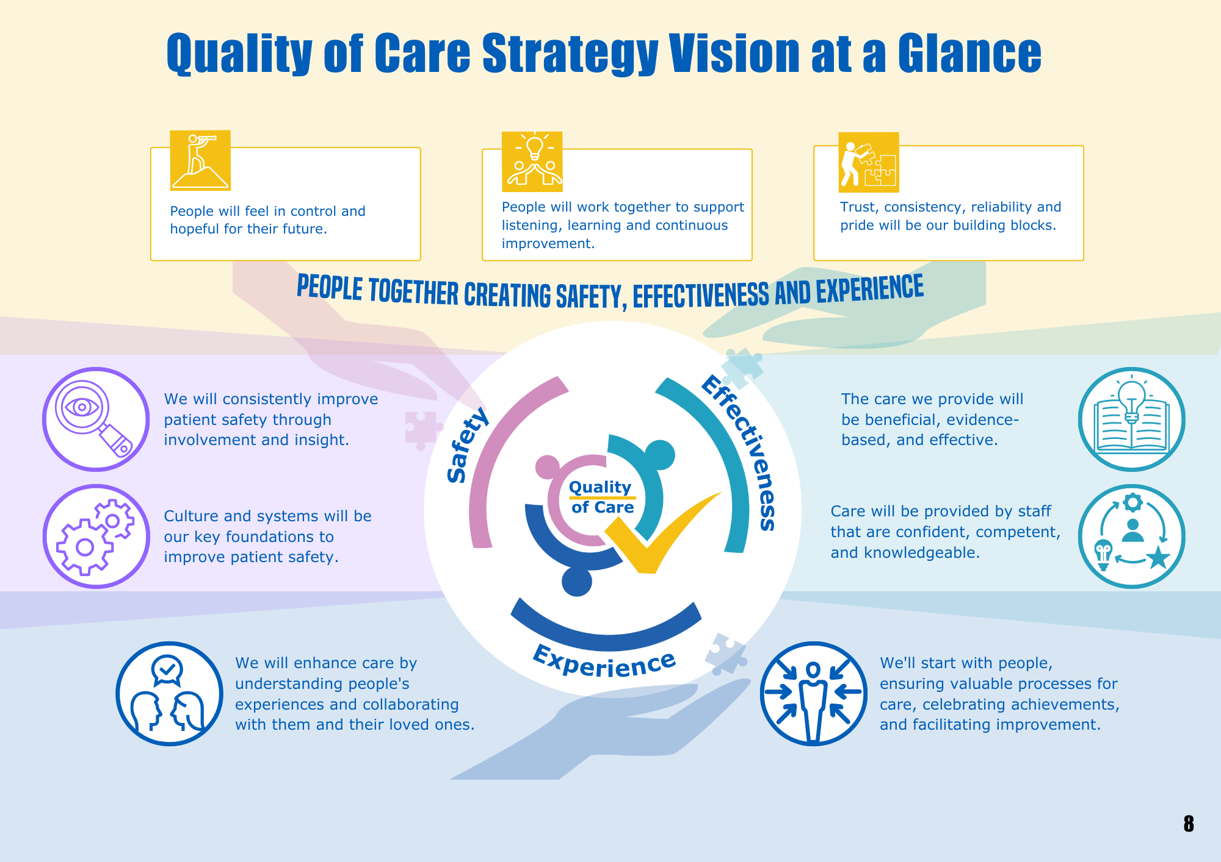
The Future Direction – Quality of Care Strategy and Programme of Delivery
Our Quality of Care Strategy takes this work forward:
Co-designed with people who use our services alongside families, carers and our own teams, and gives us a holistic focus on safety, effectiveness and experience of care
It reflects the things that people using our services have told us matter to them, along with the NHS’s national quality of care standards
Our new Time to Care clinical model includes a much broader range of staff roles and skills and will bring more therapeutic benefit to every mental health inpatient admission; and it will help us to virtually eliminate the need for temporary staffing to keep wards safe
More involvement for our community mental health teams in inpatient admissions and discharge planning from the outset

Slide 31
The Future Direction – our overall ambition
Our overall ambition is to eradicate avoidable patient harm within our services by the end of 2026/27, focusing on key priorities including:
Completing our ongoing thematic review of themes from prevention of future deaths (PFD) reports and learning and improving from these
Continuing to work with partner organisations to reduce the risk of suicide among particular groups of patients
Continuing to develop and improve support for children and young people transferring to adult services
Working with our partners to develop and implement our new single shared electronic patient record
Developing a centralised Safety and Lessons Management System to collect and analyse data from a range of sources to address issues quickly, improve the quality of investigations and responses to incidents and embed learning across the Trust
Using evidence and best practice, such as digital solutions - MAST and Oxevision - to ensure our care is reliable, consistent and meets the needs of our patients
Introducing a new Quality Senate, a panel of staff from across professional disciplines and people with lived experience of our services, who will meet regularly to discuss priority topics related to care

Slide 32

The Future Direction – our Quality of Care Strategy
Our new Quality of Care Strategy launched in April 2024. It uses the definitions of quality of care from the NHS Constitution and the World Health Organisation and has nine priority areas:
Reducing restrictive practice
Infection prevention and control
Safeguarding
Improving physical health
Suicide prevention
Medicines optimisation
End of life care
Promoting neurodiversity
Reducing health inequalities
The full strategy is available on our website.

